Slide 1
Vehicle maintenance prediction
DSCI-6601-001 Practical Machine Learning
Sahil Khan - 202482066

Slide 2
introduction
The field of predictive maintenance is expanding quickly and has the potential to save costs, increase operational effectiveness, and improve safety in a variety of industries. The objective of this project is to create a machine learning model that can forecast whether maintenance is required for a vehicle based on a number of characteristics, such as component status, usage patterns, maintenance history, and vehicle specs. Accurately predicting future maintenance requirements enables fleet managers and car owners to plan maintenance in advance, reducing downtime, avoiding expensive malfunctions, and improving safety.

Slide 3
Problem statement
Implement AI predictive maintenance for vehicles.
Utilize incoming data to anticipate and prevent disruptions.
Minimize downtime and reduce maintenance costs.
Enhance vehicle reliability for uninterrupted operations.
Optimize maintenance schedules for efficient transportation.

Slide 4
Objective
Predicting Maintenance Needs
Build a classification model to identify whether a vehicle requires maintenance based on historical and operational data.
Optimizing Fuel Efficiency
Develop a regression model to provide actionable insights for maintaining or improving vehicle fuel efficiency by analyzing key influencing factors.

Slide 5
dataset
Attributes
Vehicle Model
Mileage
Maintenance History
Reported Issues
Vehicle Age
Fuel Type
Transmission Type
Engine Size
Odometer Reading
Last Service Date
Warranty Expiry Date
Owner Type
Insurance Premium
Service History
Accident History
Fuel Efficiency
Tire Condition
Brake Condition
Battery Status
Need Maintenance
Dimension
Columns: 20
Samples: 5000

Slide 6
Data preprocessing
Key Features
Step1: Handle Missing Values
Step2: Drop Duplicates
Step3: Feature Engineering
Step4: Applying Feature Scaling for Numerical Features and One-Hot Encoding for Categorical Features
Step5: Data Split in 75:25 ratio to train-test sets using StratifiedShuffleSplit to ensure balance and avoid skewness.

Slide 7
ML Algorithms
CLASSIFIER
Logistic Regression
Random Forest Classifier
SGD Classifier
Decision Tree Classifier
XGB Classifier
REGRESSOR
Linear Regression
Ridge Regression
Random Forest Regressor
Gradient Boosting Regressor
XGB Regressor

Slide 8
Trained Model metrics
Classifiers
Regressors
Neural Network

Slide 9
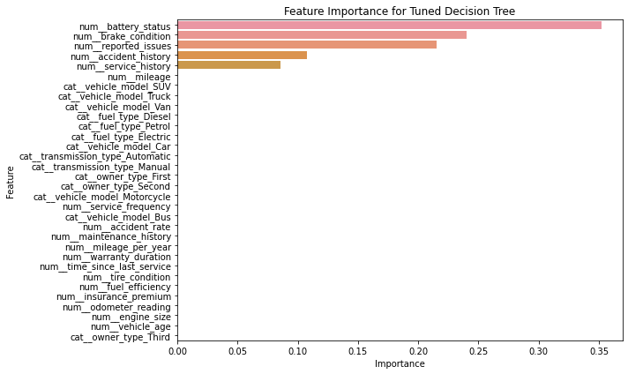
Feature importance
TOP FEATURES
Battery Status
Brake Condition
Reported Issue
Accident History
Service History

Slide 10
evaluated Model metrics
Classifiers
Regressors

Slide 11
Best Models
Classifier
Regressor

Slide 12
Prediction: user input

Slide 13
Thank You
Sahil Khan
202482066
Project Link: https://github.com/sahil82764/Vehicle_Maintenance_Prediction

